Slide 1

Student Name, ID: Sanad Alawi, 21110042
Instructor: Doctor Rami AlOuran
-------------------------------------------------------
Course: CRP (Computing A Research Project)
Date: 6 – 23 – 2025, Monday
Notes:
Good morning, Dr. Rami AlOuran
I hope you are doing well.
مرحبا , السلام عليكم دكتور رامي
أتمنى أن يكون يومك جميل وبأنك تستمتع معي في ال
Presentation
اليوم
Presentation for the CRP Course…

Slide 2
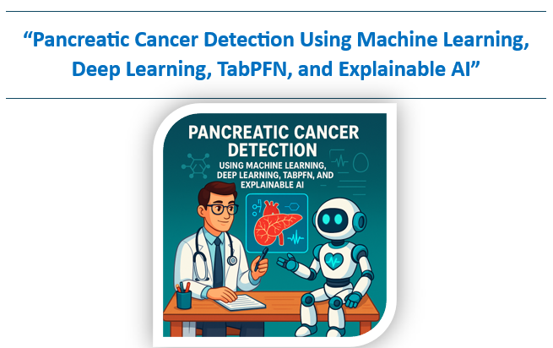
Notes:
Our research paper title is:
“Pancreatic Cancer Detection Using Machine Learning, Deep Learning, TabPFN, and Explainable AI”

Slide 3
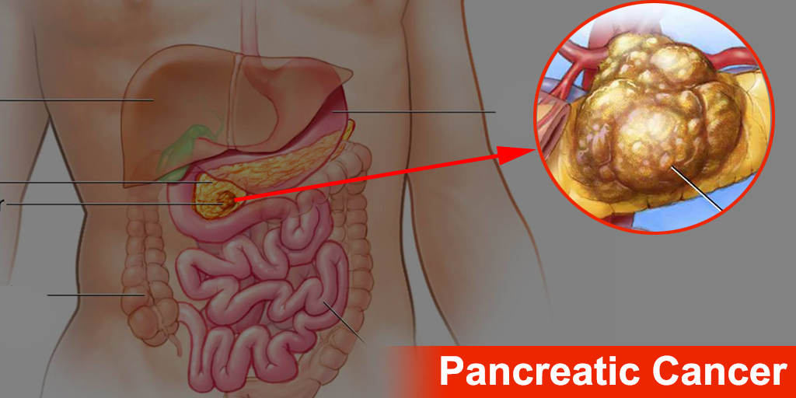
Problem
One of the deadliest cancers worldwide.
Often diagnosed at a late stage—few early symptoms.
5-year survival rate: less than 10%.
Fourth leading cause of cancer deaths globally.
Urgent need for early and accurate detection.

Slide 4
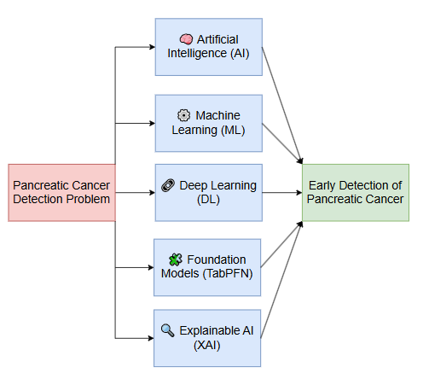
Solution

Slide 5
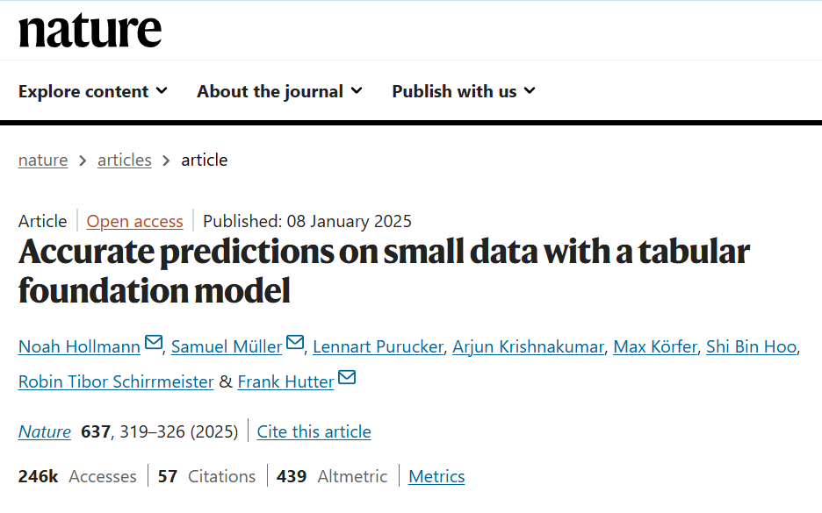
What is TabPFN?
Published in Nature (2025), showing state-of-the-art performance on many benchmark tasks.
Helps bring the power of deep learning to tabular data.
TabPFN is a Foundation Model for tabular data — like ChatGPT is for text. These models represent the future of AI.
Capable of Zero-Shot Learning — making accurate predictions without training on your data.

Slide 6
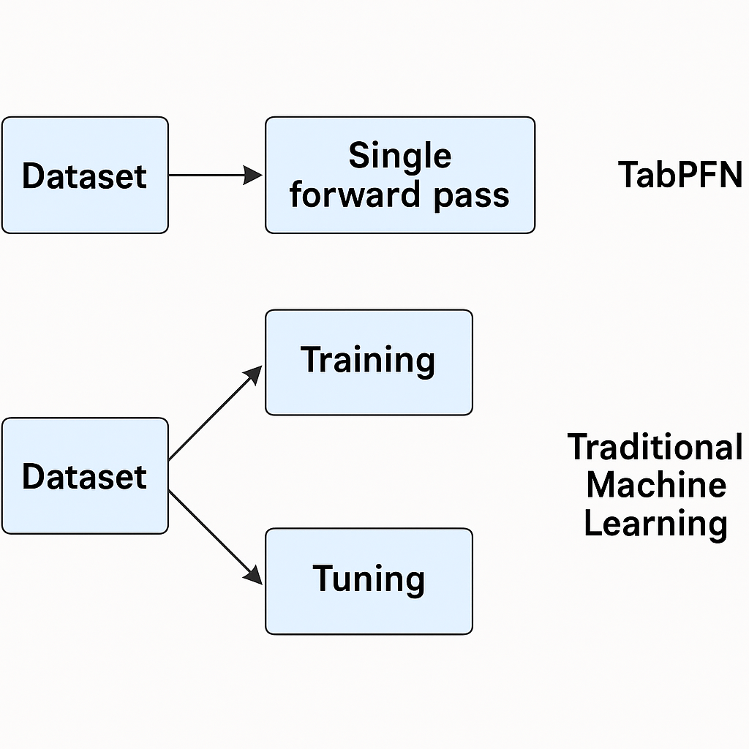
Zero-Shot Learning

Slide 7
Feature / Aspect | TabPFN | Traditional Machine Learning
Training Process | Pre-trained once on millions of synthetic datasets | Trained from scratch on the user's dataset
Learning Method | Uses a single forward pass during inference | Requires iterative training (e.g., gradient descent)
Training Time at Use | ⏱️ No training time required by the user | ⌛ Training time can be long, depending on data/model
Evaluation / Prediction Time | ⏳ Slow — takes longer due to complex forward pass-through transformer | ⚡ Fast — typically quick once trained
Hyperparameter Tuning | ❌ Not needed — model is already optimized | ✅ Required for good performance
Adaptation to New Data | Uses internal knowledge from pre-training | Learns directly from the provided dataset
Ideal for Small Datasets | ✅ Yes — performs well on limited data | ❌ Often underperforms without enough data

Slide 8
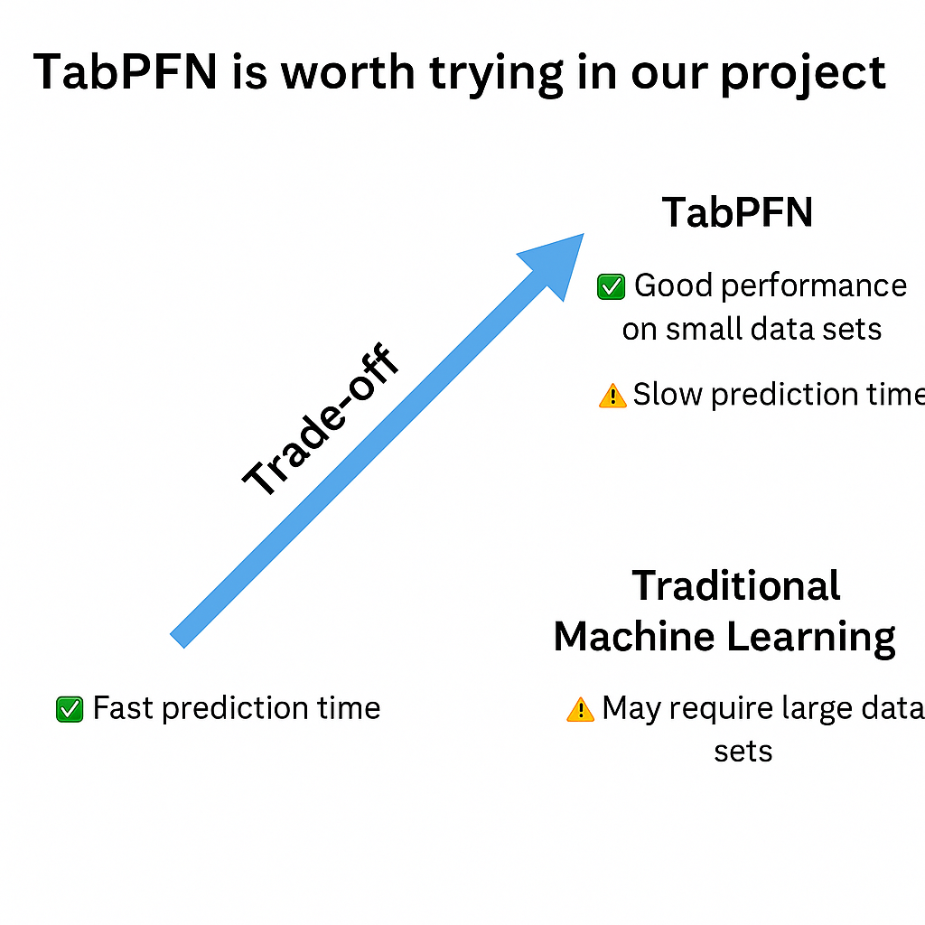

Slide 9


Primary Data → Survey

Slide 10
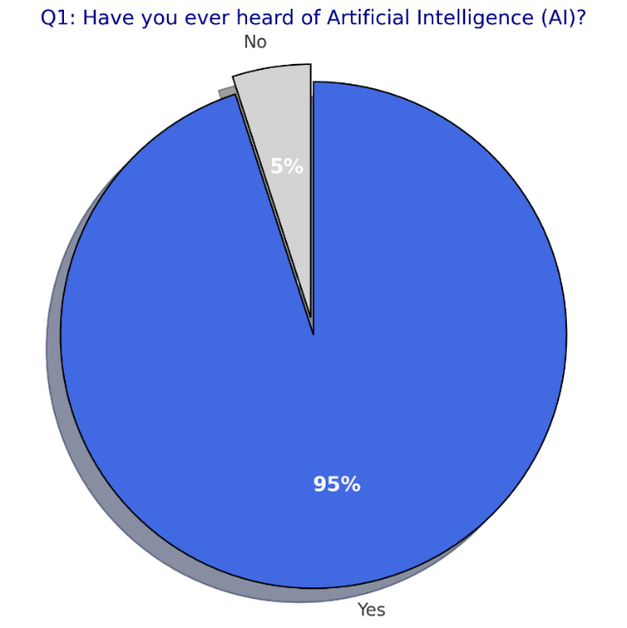
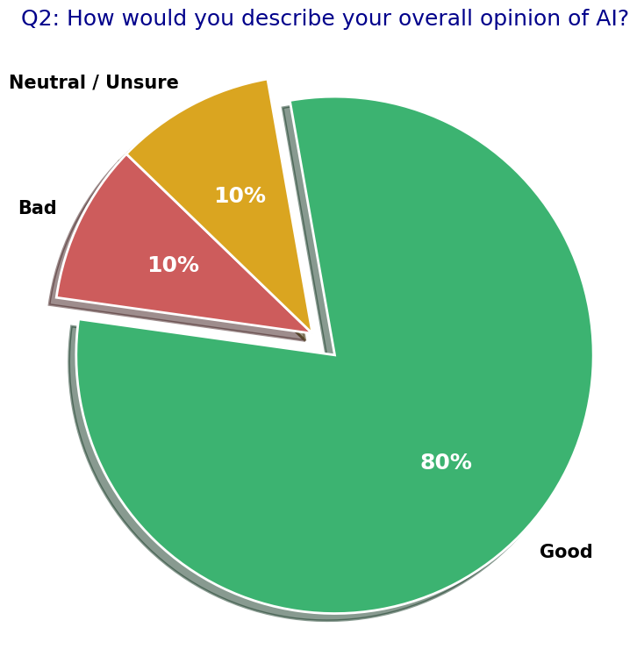
Results

Slide 11
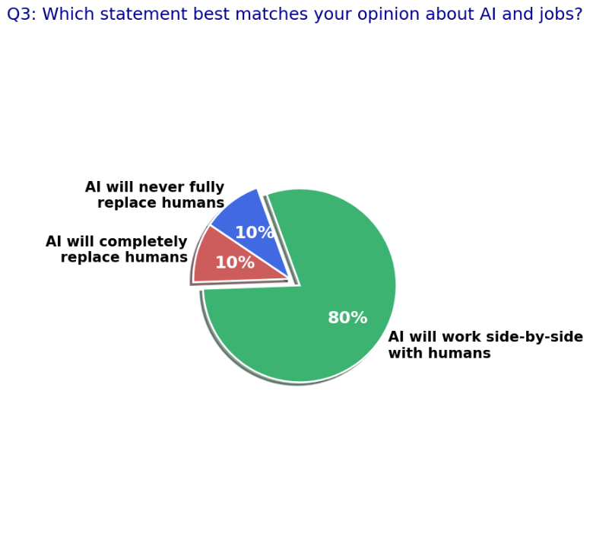
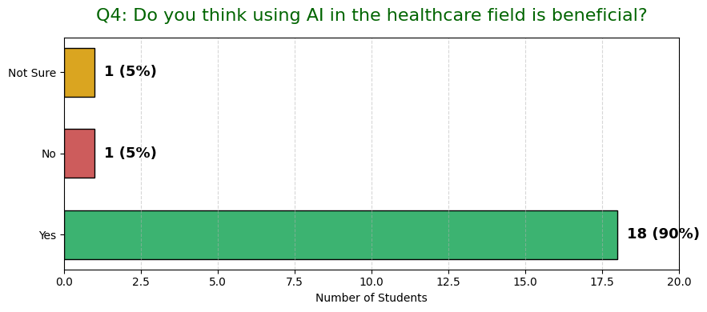
Results

Slide 12
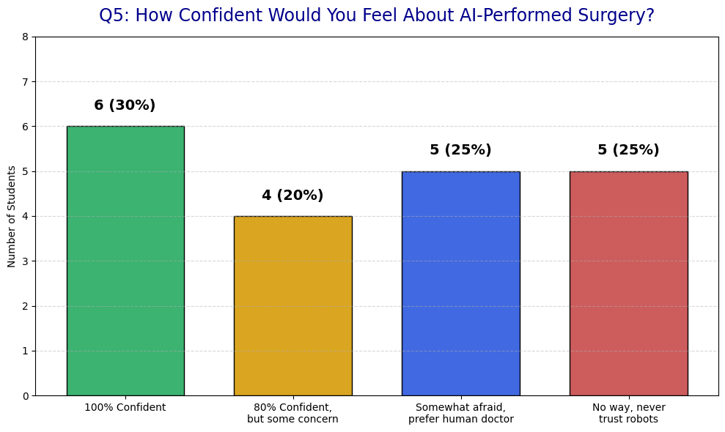
Results

Slide 13
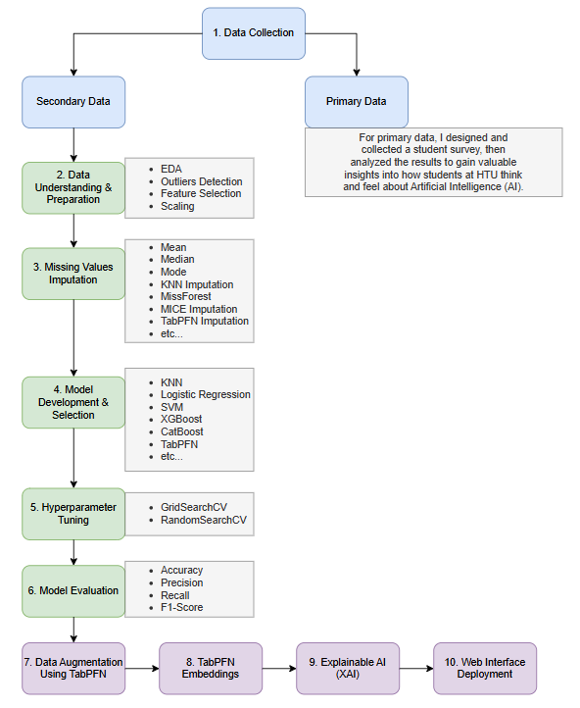

Slide 14
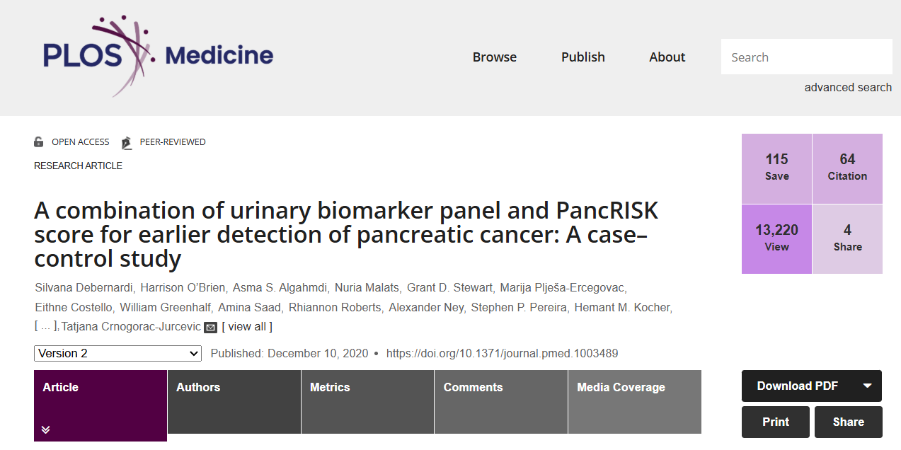
Secondary Data

Slide 15
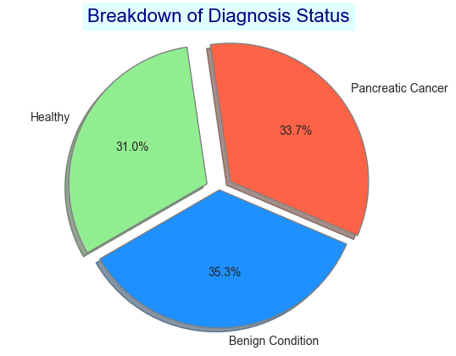
Data Understanding & Preparation
590 samples, 14 Features

Slide 16
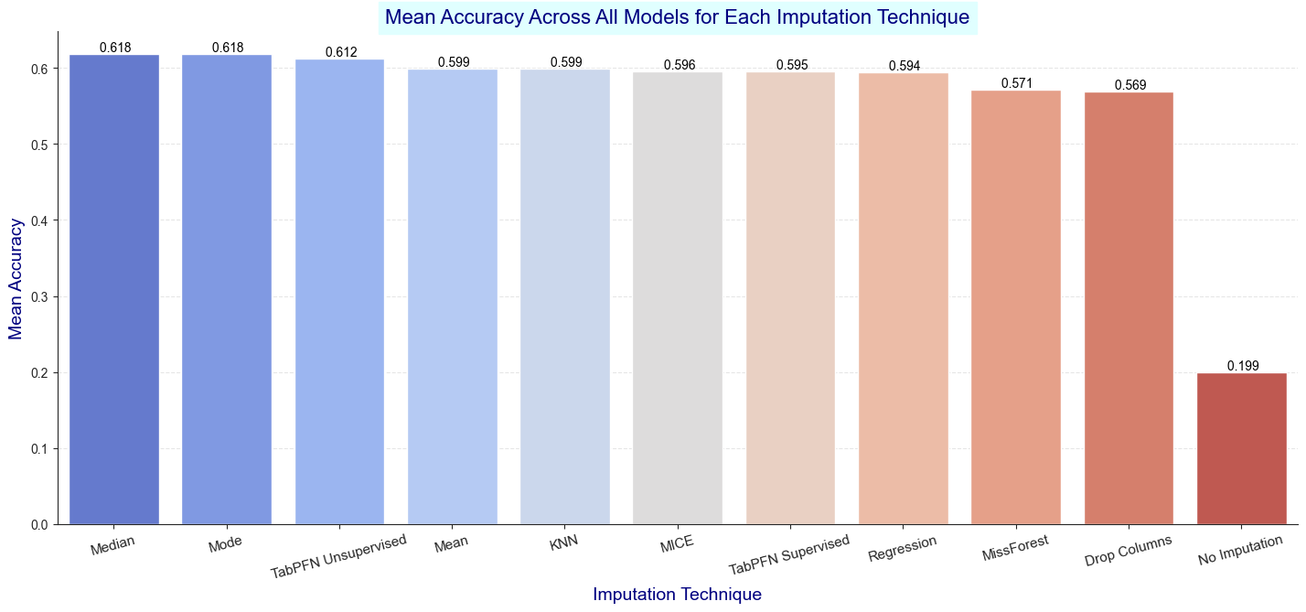
Missing Values Imputation

Slide 17
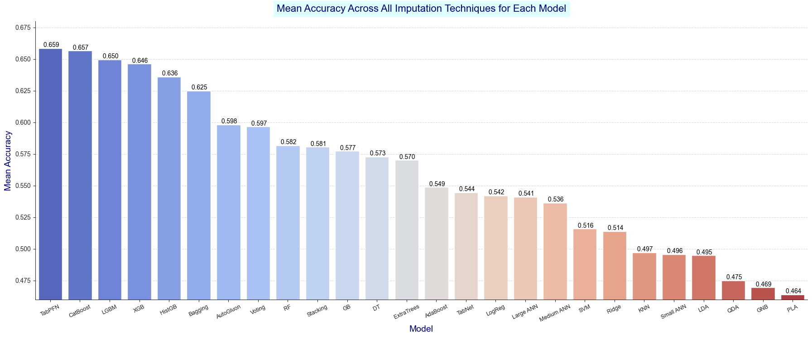
Model Development & Selection

Slide 18
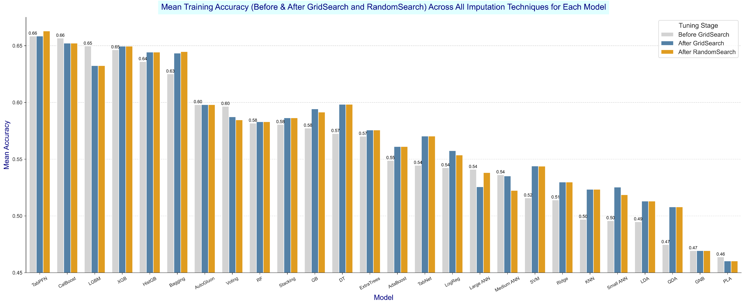
Hyperparameter Tuning

Slide 19
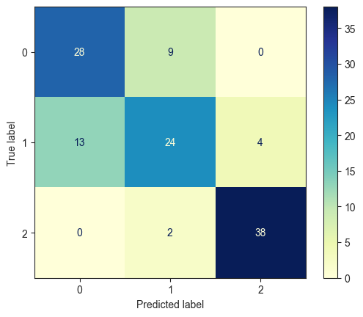
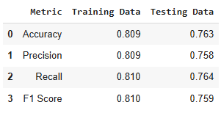
Model Evaluation

Slide 20
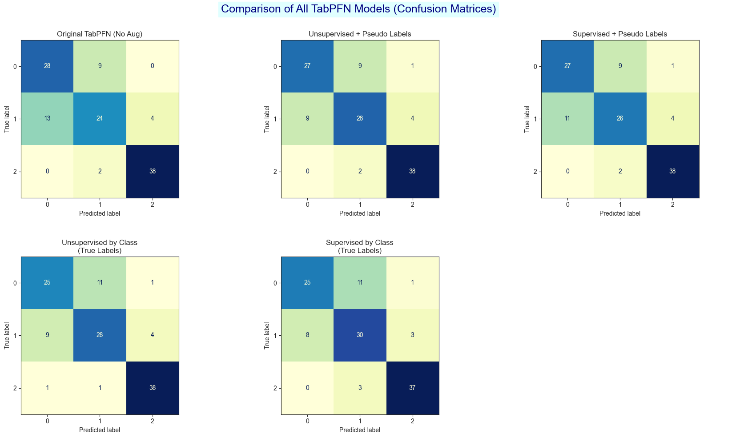
Data Augmentation Using TabPFN

Slide 21
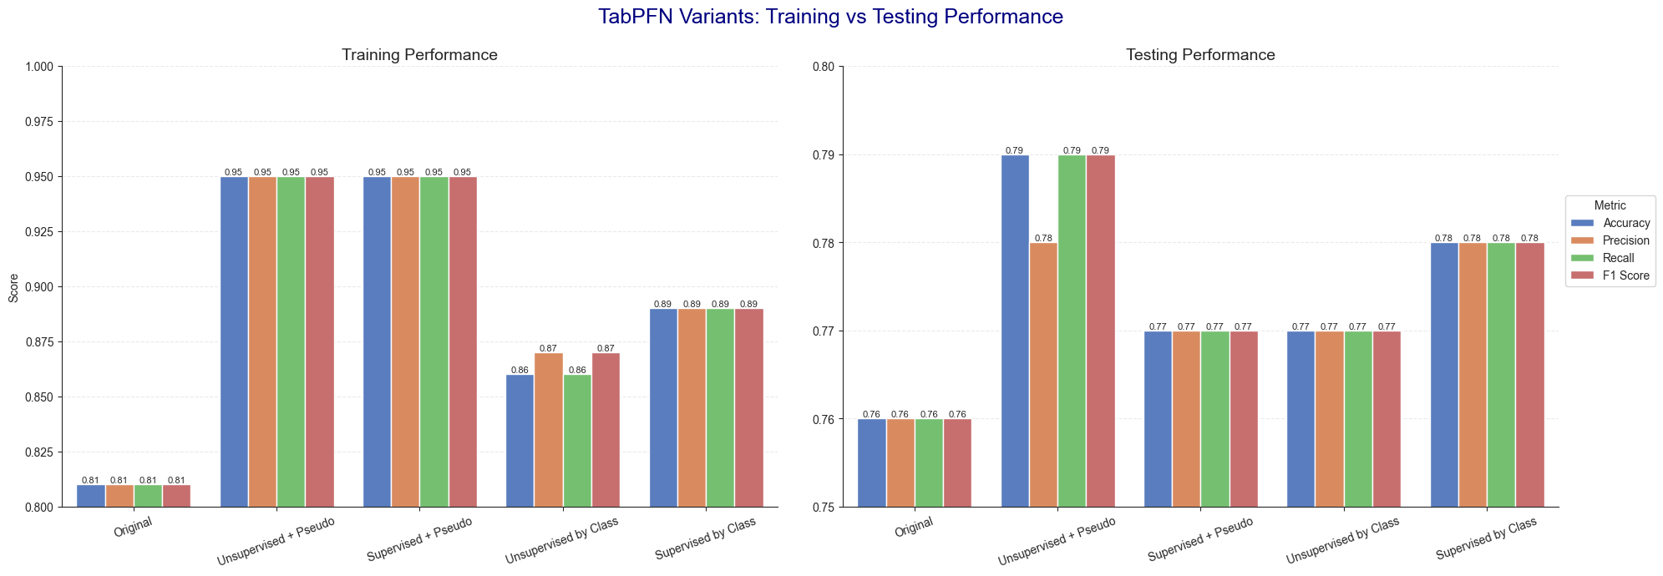
Data Augmentation Using TabPFN

Slide 22
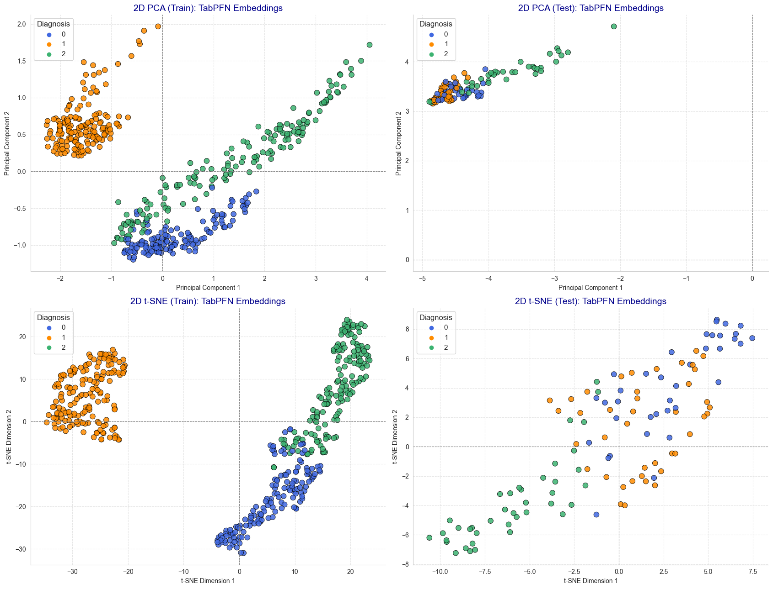
TabPFN Embeddings

Slide 23
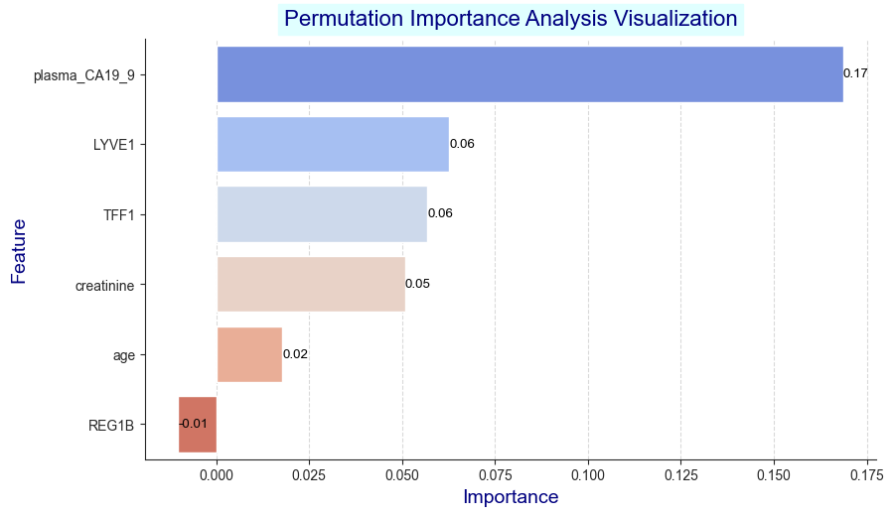
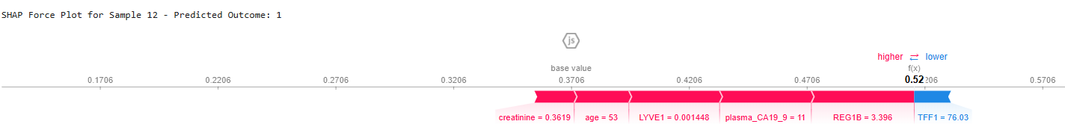
Explainable AI (XAI)

Slide 24
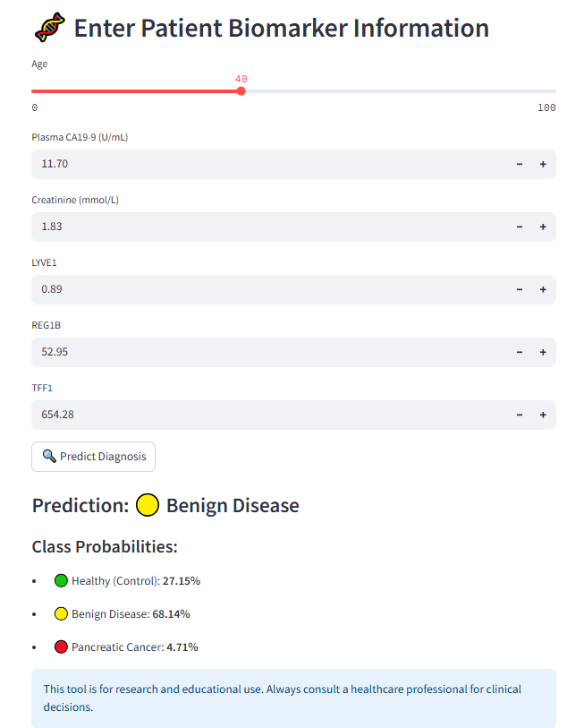
Web Interface Deployment

Slide 25
Novel Contributions of Our Research Paper!
First Application of TabPFN for pancreatic cancer detection.
Comprehensive comparison of 26 different ML, DL, and foundation models.
Evaluation of 11 imputation techniques – including TabPFN-based imputation – for missing data handling.
Introduction and validation of TabPFN data augmentation methods to improve small dataset performance.
Extraction and visualization of TabPFN embeddings using PCA, t-SNE, and UMAP for new clinical insights.
Integrated Explainable AI (XAI) techniques (SHAP, permutation importance) for model interpretability.
Developed a user-friendly web application for real-time cancer risk prediction by clinicians.

Slide 26
Future Work and Limitations!
Test TabPFN model on additional medical datasets to confirm generalizability.
Explore more advanced and automated hyperparameter tuning using cloud computing or GPUs.
Incorporate more evaluation metrics, such as ROC curve and AUC score.
Experiment with automated feature selection techniques to enhance model performance.
Expand explainable AI analysis with more visualization tools (e.g., LIME, more SHAP plots).
Increase sample size for the primary data survey and conduct interviews with healthcare experts.

Slide 27
The End ☺

